Slide 1
WHAT pricing strategies can BIG MOUNTAIN RESORT ADOPT to generate 20% ADDITIONAL REVENUE by the end of the season?
Context
Success Criteria
Montana’s Big Mountain Resort is one of the famous ski destinations in the US, attracting around 350,000 visitors annually due to its stunning views of Glacier National Park and Flathead National Forest.
The recent addition of a chair lift has led to a $1,540,000 increase in operating costs for the business this season. The planned pricing strategy involved setting a premium above the average price of resorts in its market segment, raising questions about whether the resort is maximizing its facilities.
Data-driven price adjustment that will generate 20% additional revenue for the business by the end of the season.
Constraints
Lack of business insights on overall operating costs, actual visitors, and sales data
Weather changes and conditions that could impact operating costs and sales
Marketing budget for introducing new price schemes
Other pricing adjustments (i.e. off-season promotions, discounts, etc.)
Scope
The pricing strategy will be based on a model that uses the available market data
The use of cost-plus, value-based, and dynamic pricing strategies are not in scope
Additional revenue forecast will be based on available data and generated model

Slide 2
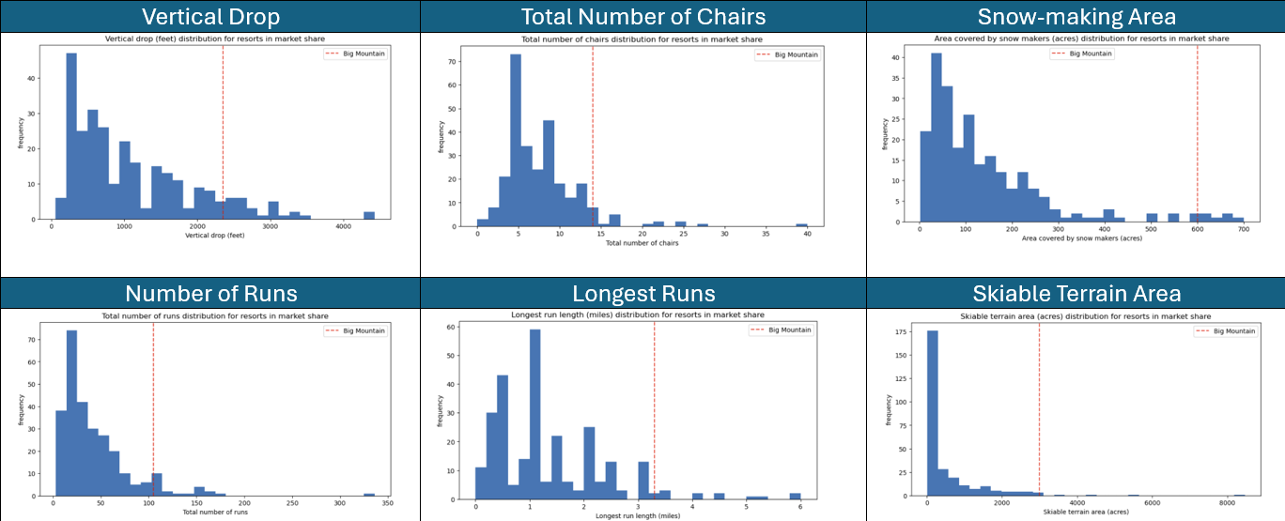
FINDINGS AND RECOMMENDATIONS
Findings:
Facility Improvement Options:
Actual Price (Weekend): $81.00
Predicted Price (Weekend): $95.87
No. | Considerations | Results
1 | Close 1 – 10 runs | 1 close = no difference. 2 to 3 close = reduces support for price increase 3 to 5
2 | Vertical drop + 150 ft, Chair lift + 1 | $1.99 price increase $3,474, 638 revenue increase (end of season)
3 | Vertical drop + 150 ft, Chair lift + 1, Snowmaking + 2 acres | Same as Scenario 2.
4 | Longest run + 0.2 mi, Snowmaking + 4 acres | $0 addt’l revenue. No impact.
BMR is undercharging.
Facilities can support a higher price.
BMR is doing well in these facilities and features. so it is in a very good position to command a higher price.
Recommendations:
Consider implementing Option No. 2
Scenario 2 or 3 may generate $3,474, 638 in revenue, but the operating costs for everything but chair lift maintenance are all unknown
Moving forward track operating and maintenance expenses, visitors, and sales
For new features and parameters introduced, review and reassess the model

Slide 3
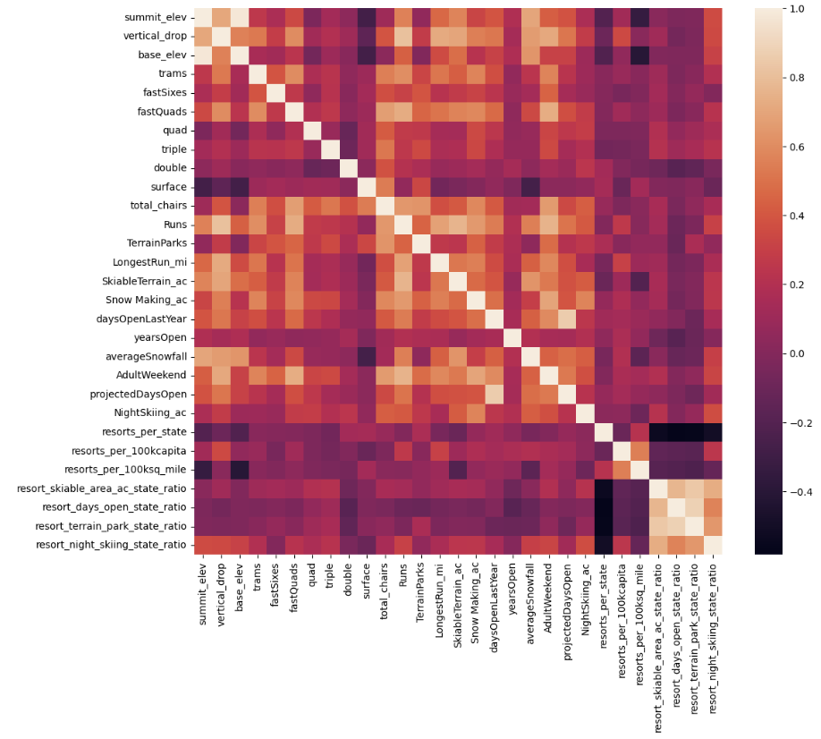
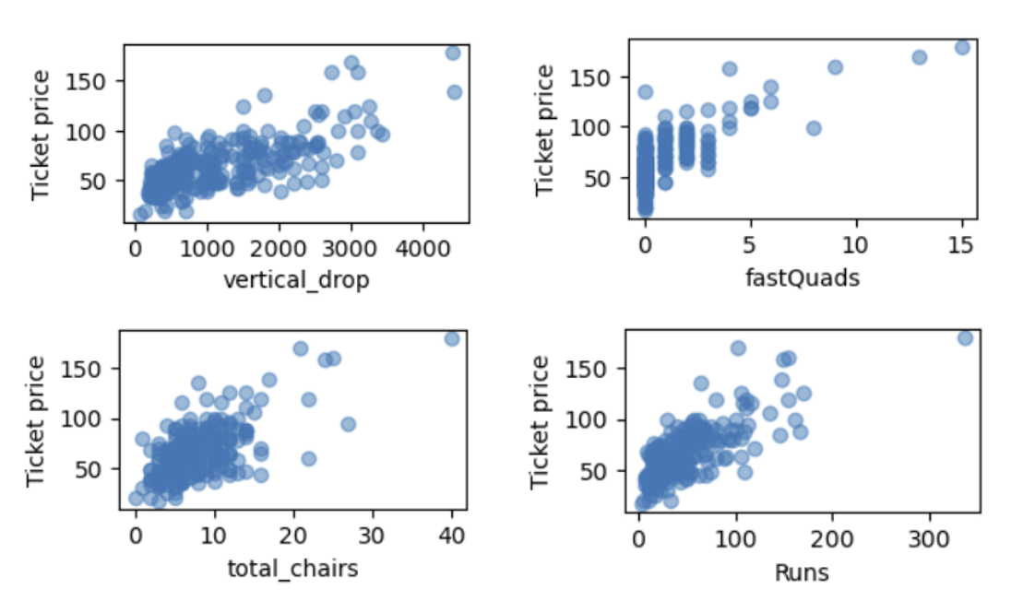
EXPLORATORY DATA ANALYSIS
Major Observations and Activities:
Weekend Price was set to be the target feature as the Weekday prices have a relatively higher number of missing values found during Data Wrangling
PCA transformation was utilized to find the relationships between the features, ordered them by the variance they explain, and worked towards building a pricing model that considers all states (equally) together.
Feature Engineering by adding State Resort “Competition” features focused on computing the ratios of certain useful features.
The feature correlation heatmap indicated a positive correlation between the ticket prices and:
the number of fast Quads,
the snow-making area covered,
the total number of chairs,
the night-skiing ratio,
the vertical drop.
The scatterplots of features also showed a strong positive correlation between price and vertical drop. Other features which exhibited positive correlation with price that appeared interesting and useful:
fast Quads
total runs
total chairs

Slide 4
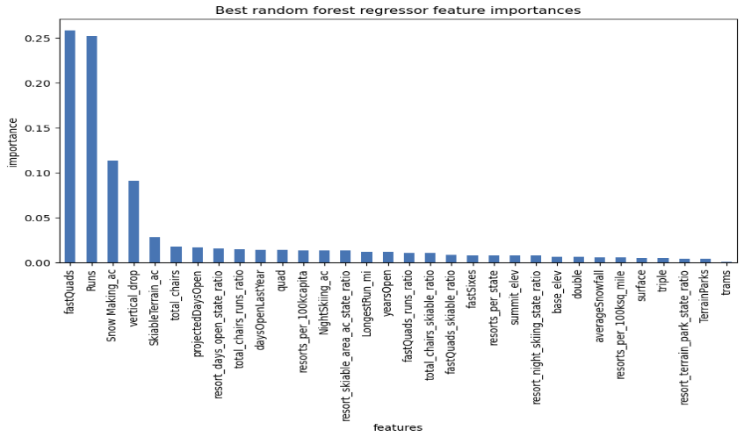
MODELING
Major Observations and Activities:
A train/test split was used to build the machine learning model with a 70:30 ratio for train and test data.
The dataset was tried in both Linear Regression and Random Forest Models.
Features that came up as important in the modeling included:
vertical_drop
Snow Making_ac
total_chairs
fastQuads
Runs
LongestRun_mi
trams
SkiableTerrain_ac
Strength of features that determine the price (RF):

Slide 5
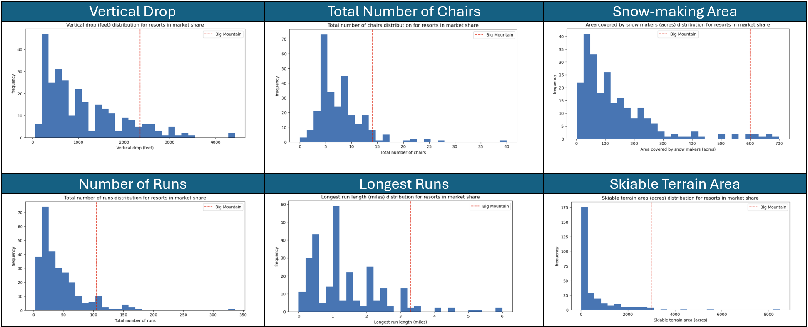
MODELING SUMMARY
Model Selection
Of the two models that were developed and assessed, the Random Forest model was considered for the final model selection as it has a lower MAE and less variability than the Linear Regression model.
BMR sits well in these features compared to other resorts in the market, enough to justify the price adjustment.
Expected vs. Actual Price:
Actual Price (Weekend): $81.00
Predicted Price (Weekend): $95.87

